Slide 1
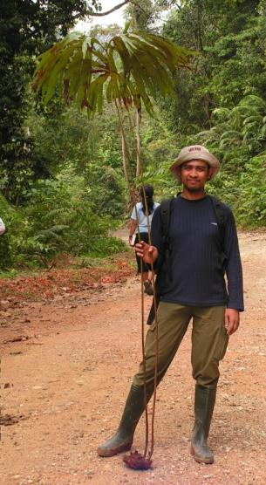
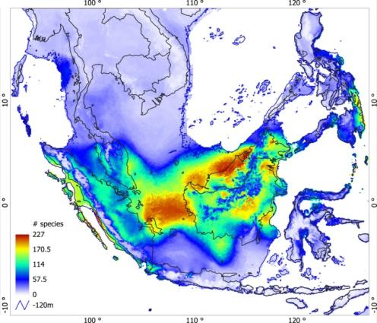
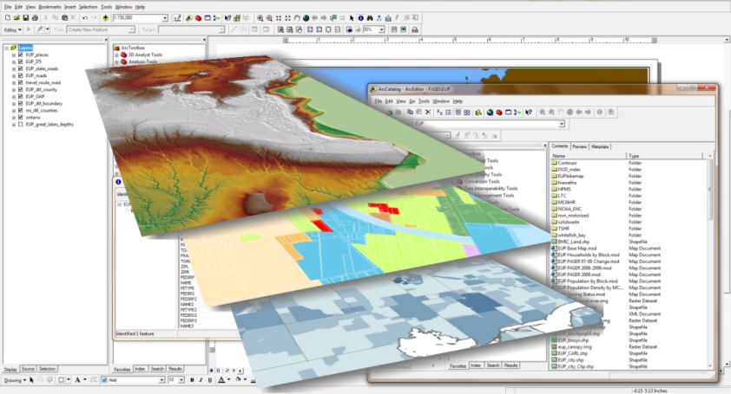
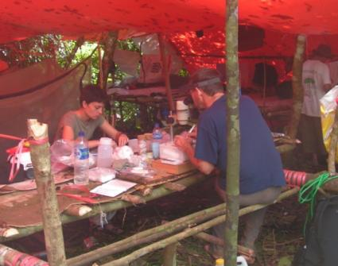
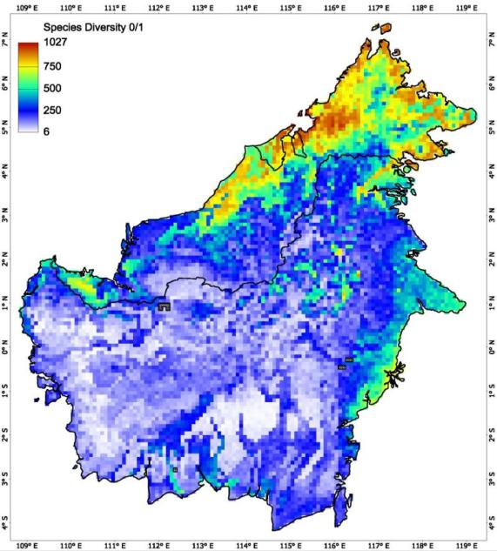
Species Distribution Modelling and its suite of applications
Niels Raes Edinburgh, November 5, 2013

Slide 2

Outline
What are species distribution models (SDMs)?
SDMs, how do they do it?
Statistical testing with a null-model.
SDM applications.
Notes:
Topics of lecture

Slide 3
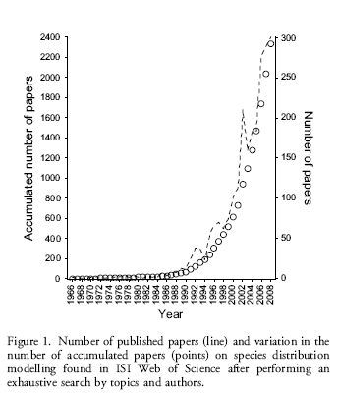
Species Distribution Modelling - History
Lobo et al. 2010 Ecography 33: 103-114
Search on ISI web of knowledge resulted in 945 papers for 2010
Notes:
History of species distribution modelling: how often SDM publications, taken from Web of Science (searching on topics and authors). Exponential increase.

Slide 4
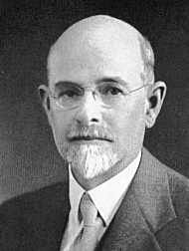
Species Distribution Modelling - History
‘Broad’ definition:
Approaches based on relationships between known occurrences of species and features of the ecological and environmental landscape.
The earliest applications of this principle were those of Joseph Grinnell in the 1910s and 1920s who used the spatial distribution of occurrences of species to infer limitations in their distributions.
Joseph Grinnell
Notes:
What is SDM, en meteen Niche theorie

Slide 5
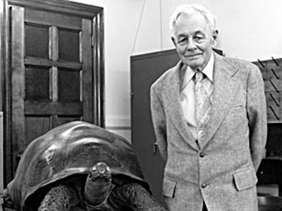
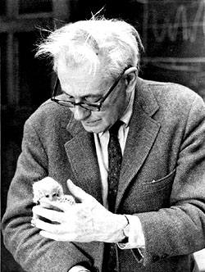
Species Distribution Modelling - History
Most models build on Evelyn Hutchinson’s n-dimensional niche hyper-volume.
From Hutchinson, G.E. 1957. Concluding remarks. Cold Spring Harbor Symposia on Quantitative Biology 22: 415-427.

Slide 6
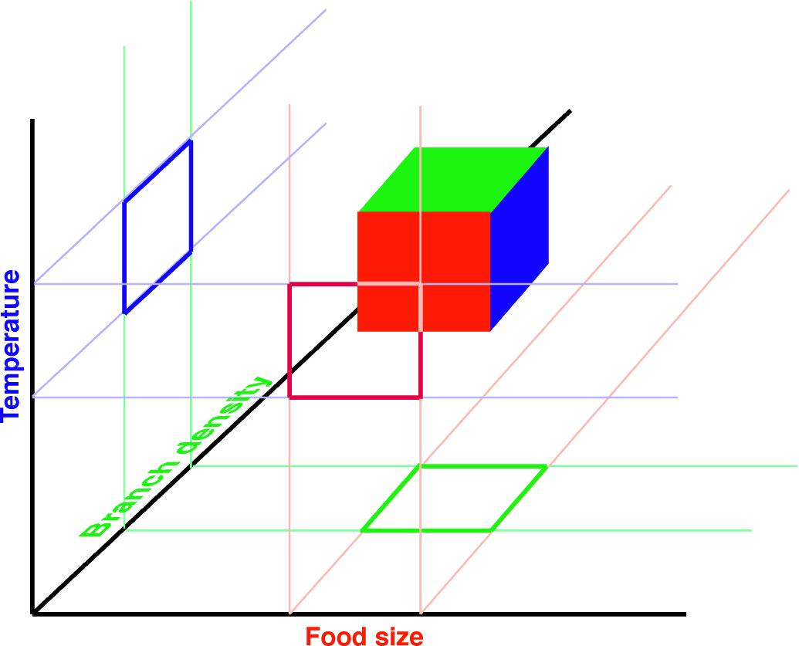

Species Distribution Modelling - History
Hutchinson’s n-dimensional niche hypervolume
Notes:
Niche van aap: waar optimaal op basis van drie variabelen, meer natuurlijk toe te voegen.

Slide 7
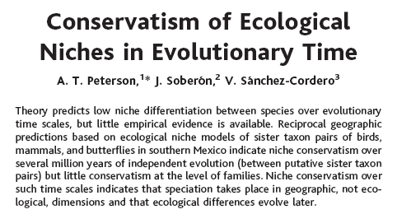

Species Distribution Modelling - History
A. Townsend Peterson
Notes:
Geimplementeerd in niche models 1999 (GARP): belangrijk dat niche voorkeuren conservatief zijn, zo terug in tijd en voorwaarts te modelleren.

Slide 8
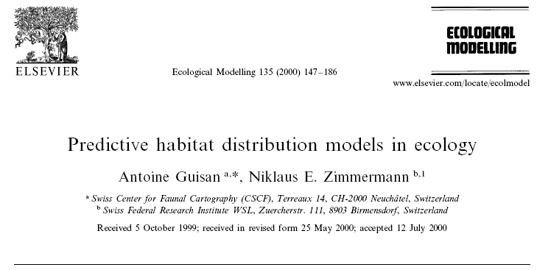
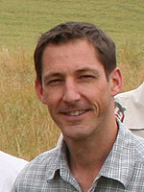

Species Distribution Modelling - History
Cited 4473 times on 9 December 2015 Google Scholar
Antoine Guisan
Niklaus Zimmermann
Notes:
First model makers, already cited almost 4000 times.

Slide 9
Principles of species distribution modelling
Species Distribution Models (SDMs) use distributional information (georeferenced collections) in combination with environmental predictors to estimate the ecological niche and/or potential distribution of species.
A species niche consists of 3 classes of determinants:
Abiotic conditions, i.e. temperature, precipitation.
After: Soberon & Peterson 2005 Biod. Inf. 2: 1-10
Notes:
Hoe werkt SDM: eerst definitie, dan abiotische factoren belangrijk

Slide 10

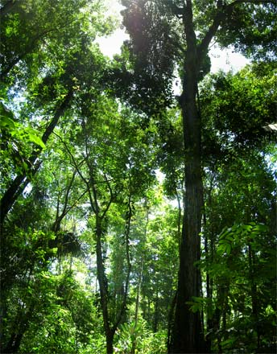
Principles of species distribution modelling
Species niche - Abiotic
Abiotic
Temperature, precipitation, etc.
Notes:
Abiotische niche factoren.

Slide 11
Principles of species distribution modelling
Species Distribution Models (SDMs) use distributional information (georeferenced collections) in combination with environmental predictors to estimate the ecological niche and/or potential distribution of species.
A species niche consists of 3 classes of determinants:
Abiotic conditions, i.e. temperature, precipitation.
Biotic conditions necessary for survival and reproduction, i.e. absence of predators, presence of pollinators, etc.
After: Soberon & Peterson 2005 Biod. Inf. 2: 1-10
Notes:
Biotische belangrijk, nu geen gegevens, niet gebruikt.

Slide 12
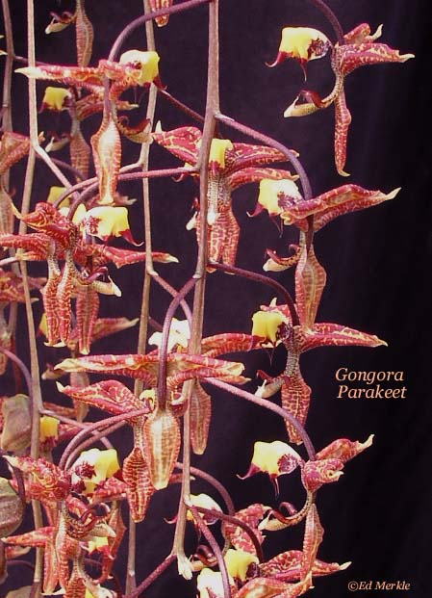
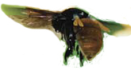
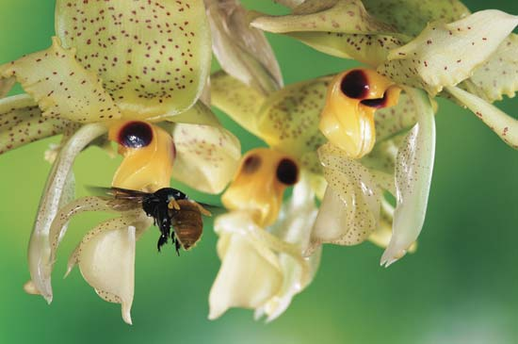
Principles of species distribution modelling
Species niche - Biotic
Biotic
Presence pollinator and plant
Notes:
Voorbeeld van biotische factoren: bestuivers.

Slide 13
Principles of species distribution modelling
Species Distribution Models (SDMs) use distributional information (georeferenced collections) in combination with environmental predictors to estimate the ecological niche and/or potential distribution of species.
A species niche consists of 3 classes of determinants:
Abiotic conditions, i.e. temperature, precipitation.
Biotic conditions necessary for survival and reproduction, i.e. absence of predators, presence of pollinators, etc.
Accessibility, i.e. within dispersal capabilities.
After: Soberon & Peterson 2005 Biod. Inf. 2: 1-10
Notes:
Accessibility depends on dispersal capabilities: often high with r-specialists, low with k-specialists.

Slide 14


Principles of species distribution modelling
Species niche - Accessibility
Accessibility
Notes:
In this case rain forest on the right not accessible for the orchid as it cannot pass the dessert.

Slide 15
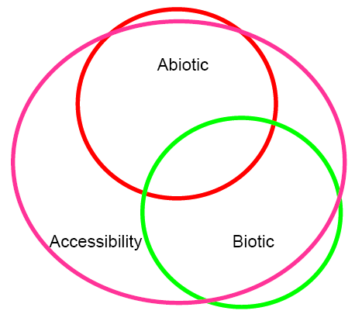
Principles of species distribution modelling
Species niche
Temperature, precipitation, etc.
Realized Niche
Presence pollinators, Absence competitors, etc.
Notes:
Niche based on abiotic, biotic and accessibility criteria: overlapping part.

Slide 16
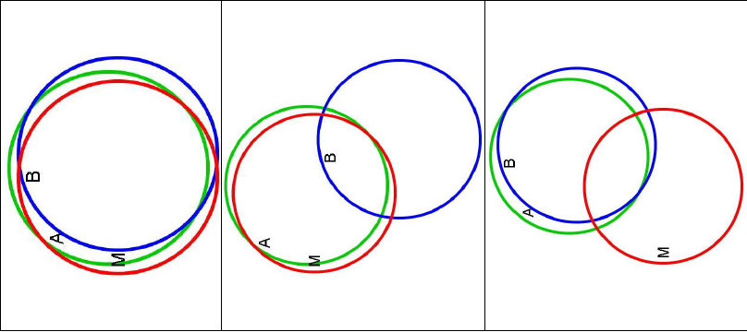
Principles of species distribution modelling
Species niche
A = Abiotic
B = Biotic
M = Accessibility
After: Soberon & Peterson 2005 Biod. Inf. 2: 1-10
Notes:
Various examples of differences in A, B and M. Left is the ideal situation as usually only A is known and A should then be representative for the other two.

Slide 17
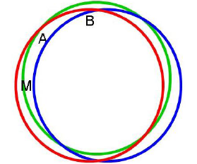
Principles of species distribution modelling
SDMs attempt to predict the potential ‘abiotic’ distribution of species by interpolating identified relationships between species presence records and ‘abiotic’ predictors
Notes:
The ideal situation A representative for other two. Also important: we only have presence data, but absence data not. Absence means often: not part of inventory, not visited, thus unknown if taxon is present or absent.

Slide 18

How do they do it?

Slide 19
Methodology – Collections
Extract all collection records for species with at least 1 record in the study area: - BRAHMS collection databases, - GBIF,
Notes:
First step: collect data, specimen records per species. Brahms: Naturalis botanical data, GBIF worldwide.

Slide 20
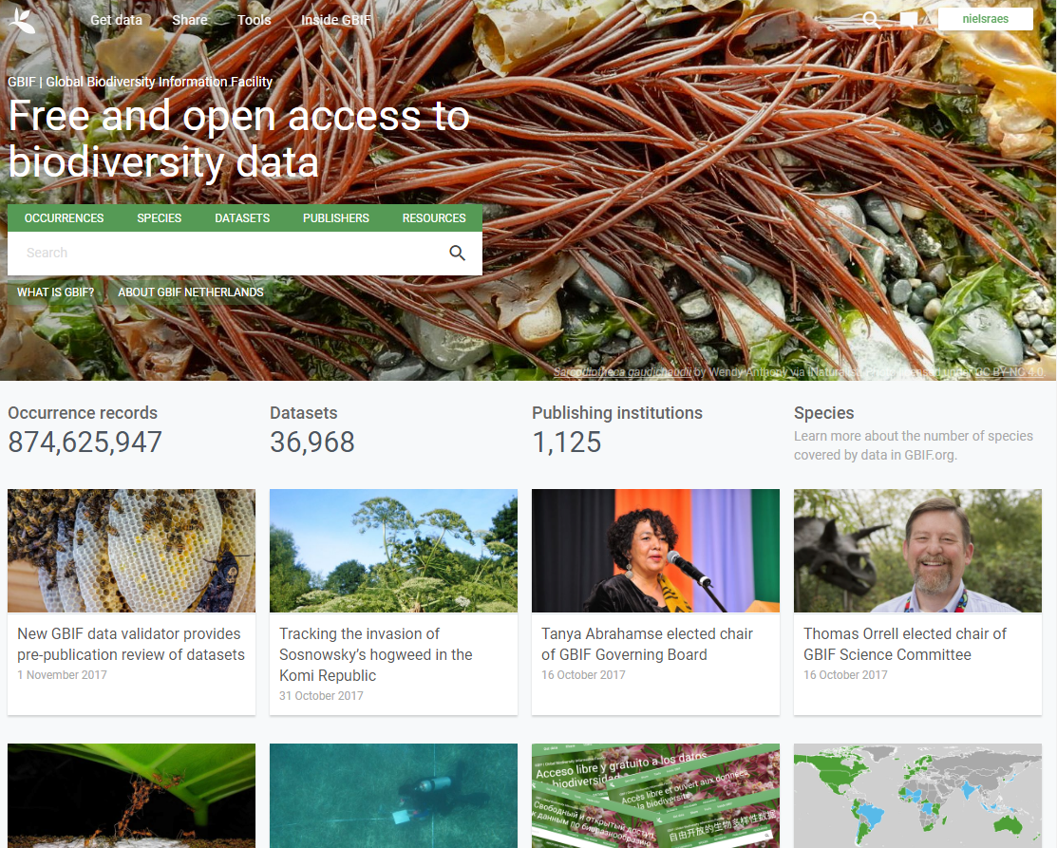
Methodology – Collections
Notes:
GBIF example

Slide 21
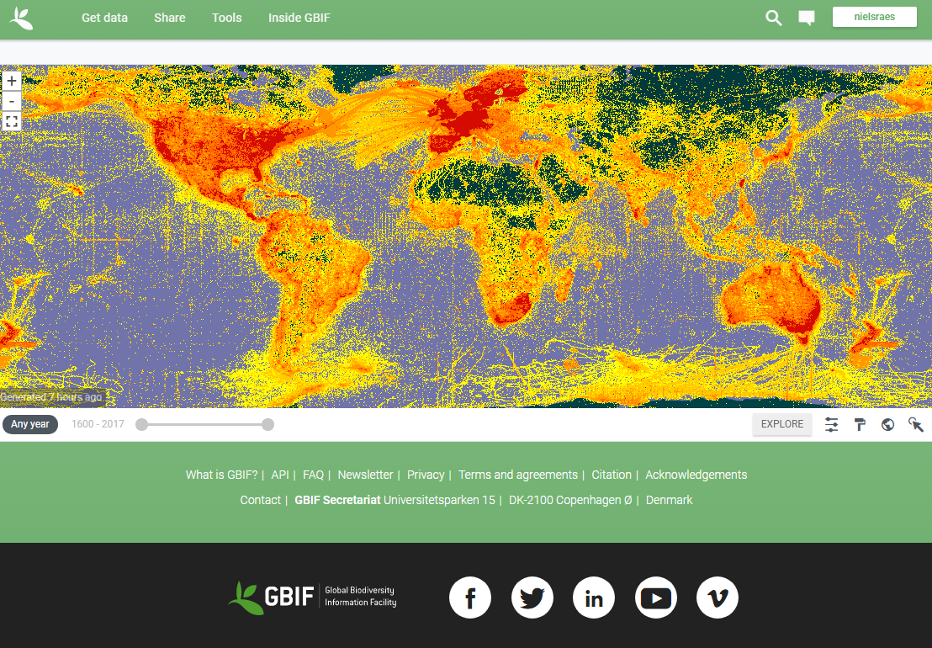
Methodology – Collections
Notes:
GBIF example

Slide 22
Methodology – Collections
Extract all collection records for species with at least 1 record in the study area: - BRAHMS collection databases, - GBIF, - SpeciesLink, - Etc.
Notes:
SpeciesLink is another source. Other herbarium databases (as long as not part already of GBIF), etc.

Slide 23
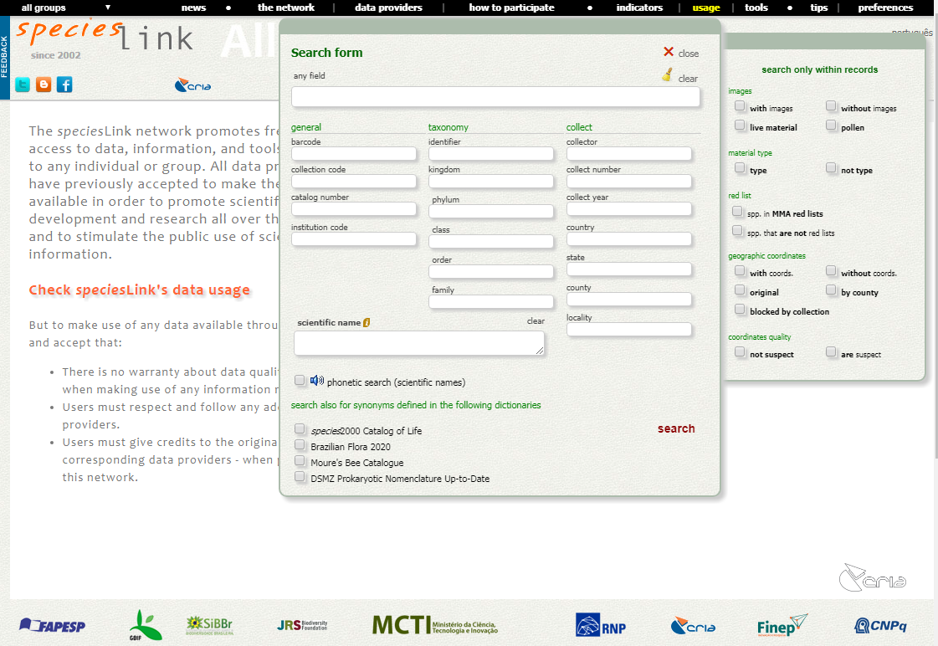
Methodology – Collections

Slide 24
Methodology – Collections
Extract all collection records for species with at least 1 record in the study area: - BRAHMS collection databases, - GBIF, - SpeciesLink, - Etc.
Clean species identifications.
Notes:
Data often not completely reliable. Second step: cleaning of identifications

Slide 25
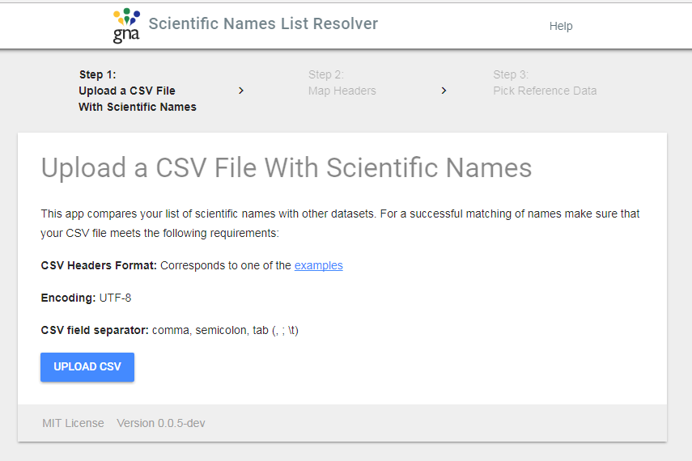
Methodology – Collections
Catalogue of Life
http://listresolver.globalnames.org/
Notes:
Check if names exist

Slide 26
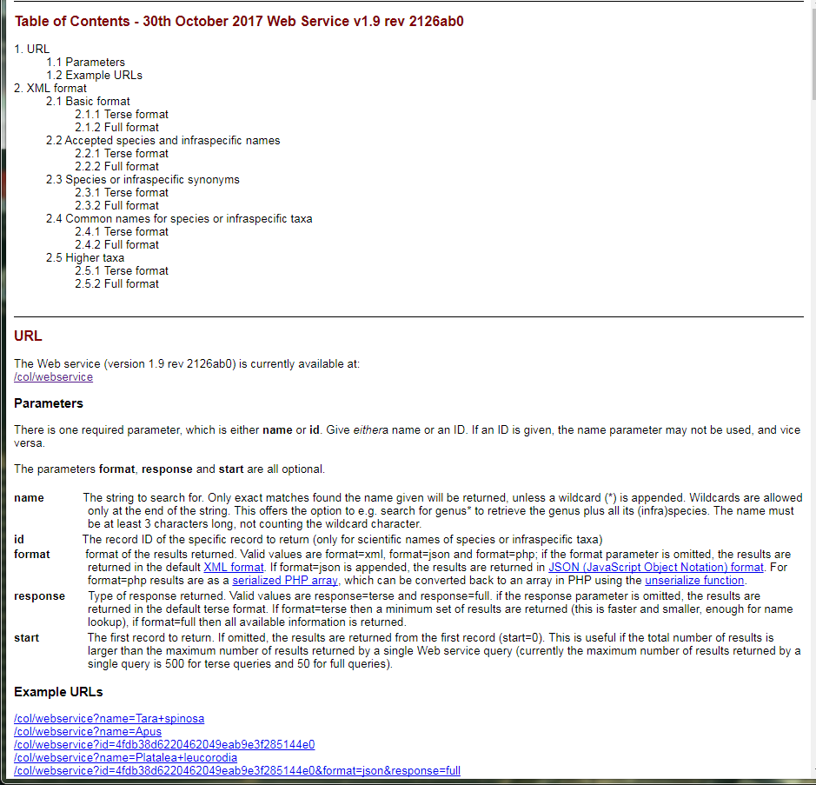
Methodology – Collections
Catalogue of Life - webservice
http://webservice.catalogueoflife.org/col/webservice
Notes:
Check if names exist

Slide 27
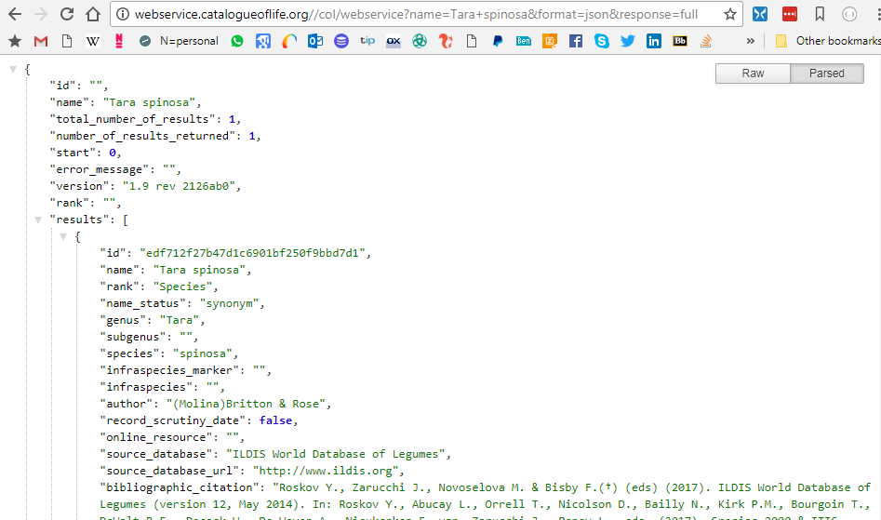
Methodology – Collections
Catalogue of Life – Tara spinoza
http://webservice.catalogueoflife.org/col/webservice
Notes:
Check if names exist

Slide 28
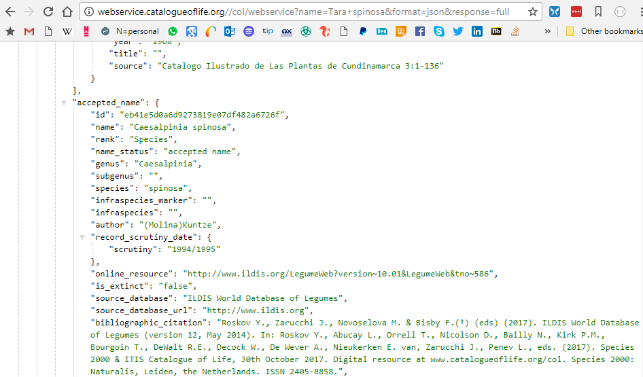
Methodology – Collections
Catalogue of Life – Tara spinoza
http://webservice.catalogueoflife.org/col/webservice
Notes:
Check if names exist

Slide 29
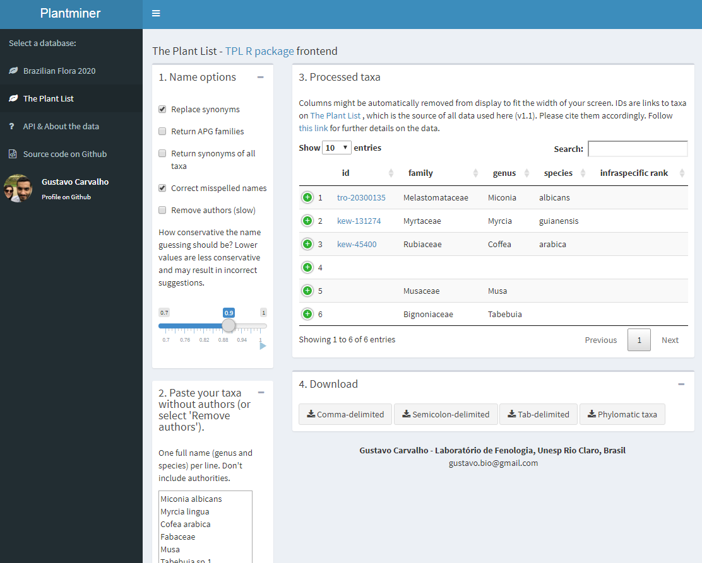
Methodology – Collections
The Plant List (TPL) through Plant Miner
http://www.plantminer.com/
Notes:
Check if names exist

Slide 30
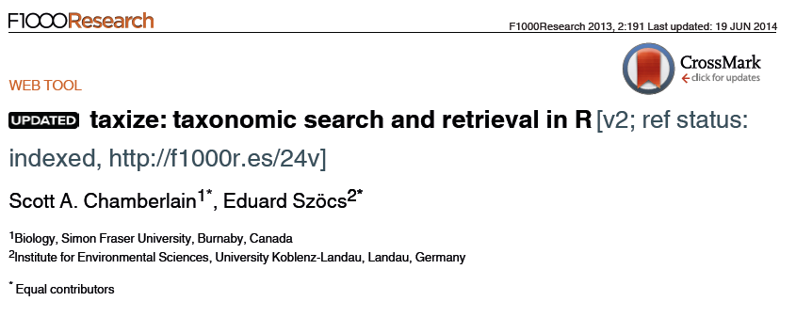
Methodology – Collections
https://cran.r-project.org/web/packages/taxize/index.html
Notes:
Two more examples of synonym cleaning.

Slide 31
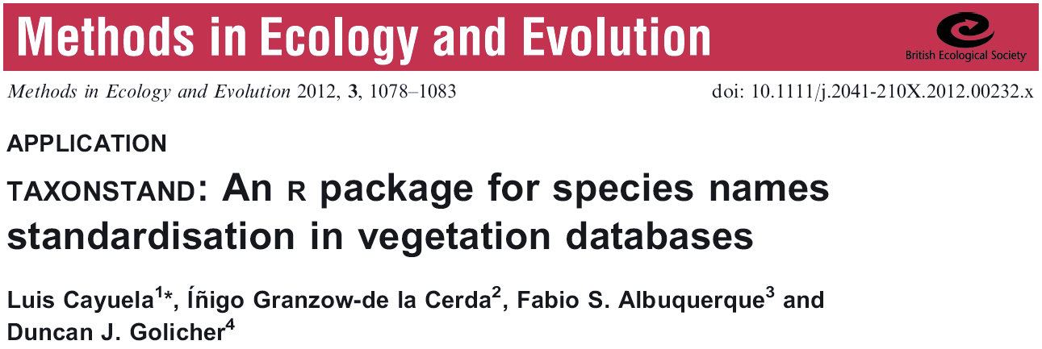
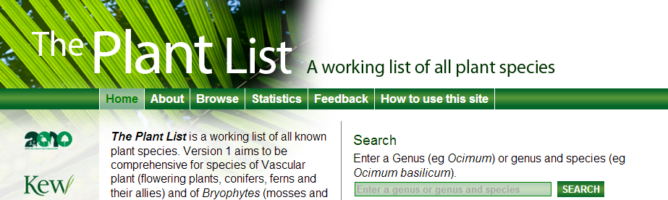
Methodology – Collections
http://cran.r-project.org/web/packages/Taxonstand/index.html
Notes:
Two more examples of synonym cleaning.

Slide 32
Methodology – Collections
Extract all collection records for species with at least 1 record in the study area: - BRAHMS collection databases, - GBIF, - SpeciesLink, - Etc.
Clean species identifications.
Georeference all collections.
Notes:
Third step: find coordinates for your collections. Practice.

Slide 33
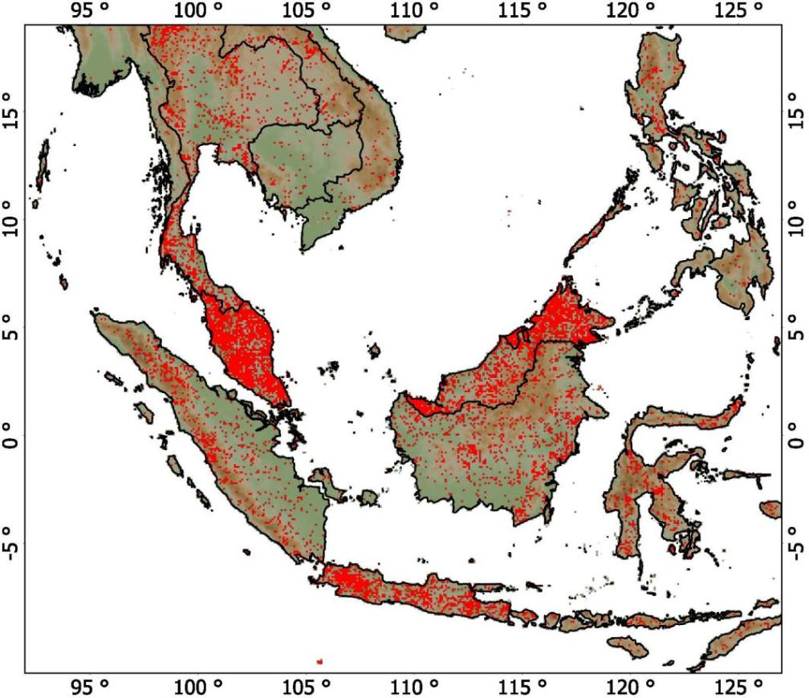
Methodology – Collections
All collection localities
Notes:
All known localities with collections in Asia.

Slide 34
Methodology – Species Distribution Models
Extract all collection data for species with at least 1 record on the Sunda Shelf from the collection databases: - BRAHMS Naturalis Biodiversity Center, Leiden - BRAHMS Forest Research Institute Malaysia - BRAHMS Singapore Botanical Gardens
Clean species identifications.
Georeference all collections.
Acquire spatial data that relates to the species’ abiotic niches.
Notes:
Fourth step: data layers with which you will make the SDM.

Slide 35
Methodology – Spatial data
Climatic data: - WorldClim (worldclim.org) - CliMond (climond.org) - GCM Downscaled (ccafs-climate.org)
Notes:
For climate data we will use WorldClim, but others are also available.

Slide 36
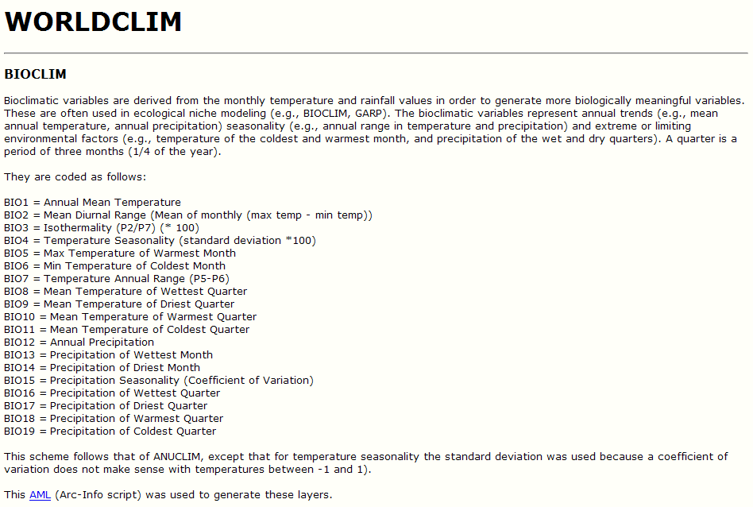
Methodology – Spatial data
Climatic data: - WorldClim (worldclim.org) - CliMond (climond.org)
Notes:
These are the 19 bioclim variables. Something not done is erase the dependent ones.

Slide 37
Methodology – Spatial data
Climatic data: - WorldClim (worldclim.org) - CliMond (climond.org)
We used the thin-plate smoothing spline algorithm implemented in the ANUSPLIN package for interpolation, using latitude, longitude, and elevation as independent variables (Hijmans et al. 2005 Int. J. Climatol. 25: 1965–1978).

Slide 38
Methodology – Spatial data
Climatic data: - WorldClim (worldclim.org) - CliMond (climond.org) - GCM Downscaled (ccafs-climate.org)
Soil/edaphic data - FAO (fao.org/geonetwork/) - ISRIC (isric.org) - Harmonised World Soil Database (iiasa.ac.at)
Notes:
Soil data were formerly taken from FAO, now from ISRIC.

Slide 39
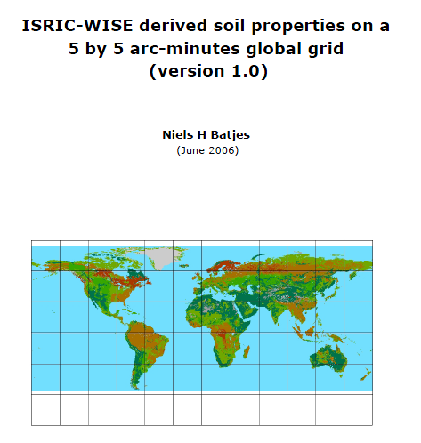
Methodology – Spatial data

Slide 40
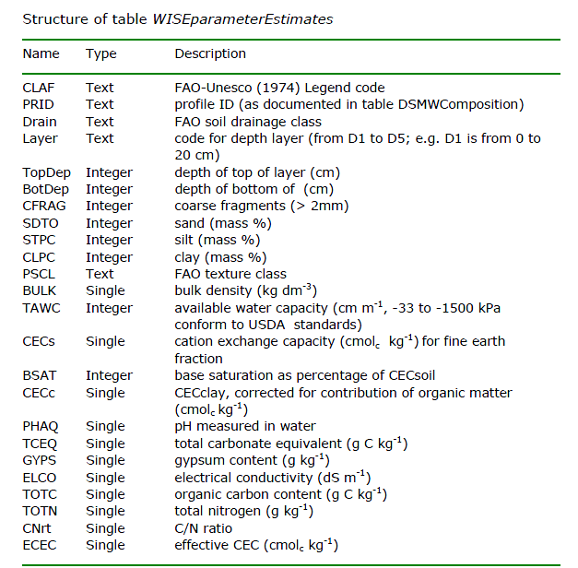
Methodology – Spatial data
Notes:
Examples of soil variables.

Slide 41
Methodology – Spatial data
Climatic data: - WorldClim (worldclim.org) - CliMond (climond.org) - GCM Downscaled (ccafs-climate.org)
Soil/edaphic data - FAO (fao.org/geonetwork/) - ISRIC (isric.org) - Harmonised World Soil Database (iiasa.ac.at)
Derived variables, i.e. Potential Evapo-Transpiration (PET)
Spatial data should be tested for correlations (| Spearman rho | > 0.7) and highly correlated variables should be omitted!
Notes:
Correlated variables omitted. We will not do and only use climate.

Slide 42
Methodology – Species Distribution Models
Extract all collection data for species with at least 1 record on the Sunda Shelf from the collection databases: - BRAHMS Leiden - BRAHMS Forest Research Institute Malaysia - BRAHMS Singapore botanical gardens
Clean species identifications.
Georeference all collections.
Acquire spatial data that relates to the species’ abiotic niches.
Model algorithm to relates species occurrence to spatial data.
Notes:
Fifth phase: select an algorithm to calculate sdms

Slide 43
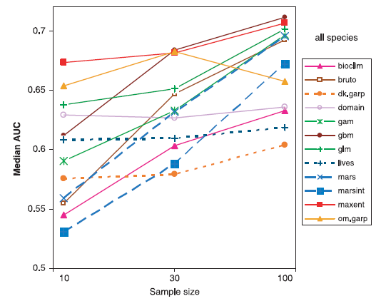
Methodology – Model algorithm
From: Wisz et al., DDI 2008
Notes:
Different algoritms, Maxent best, especially with low sample sizes.

Slide 44
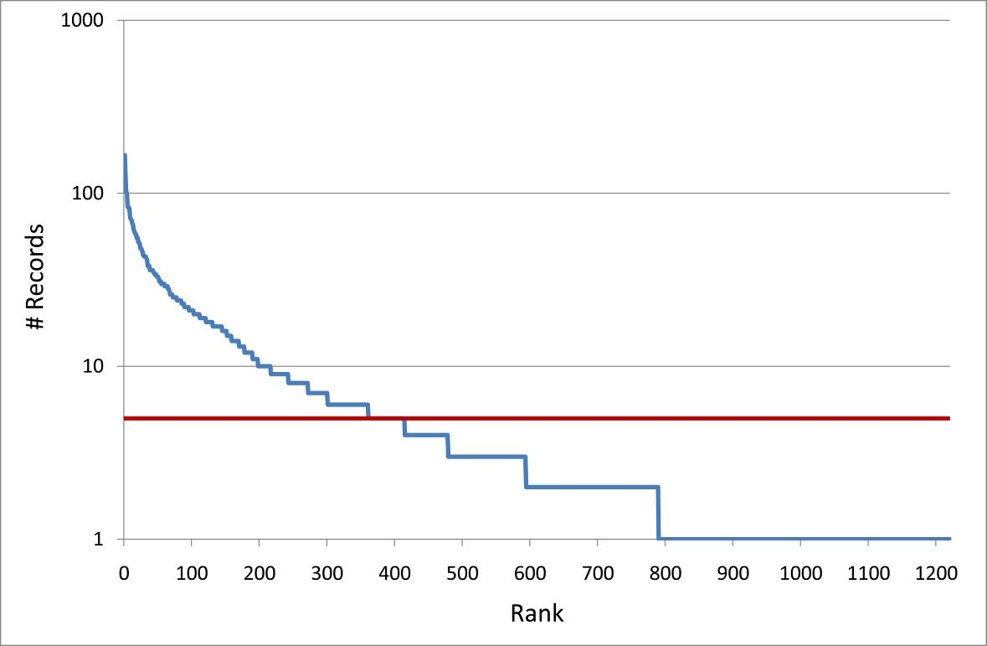
Methodology – Model algorithm
5
2/3 cannot be modelled
From: Yahara et al. 2013
Notes:
Most collections contain too few records (grid cells) and cannot be modelled.

Slide 45
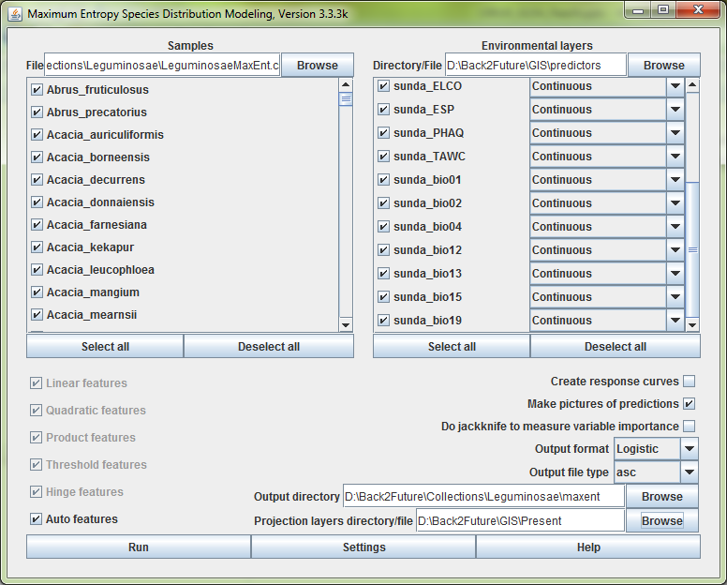
Methodology – model algorithm
Notes:
Interface of Maxent

Slide 46
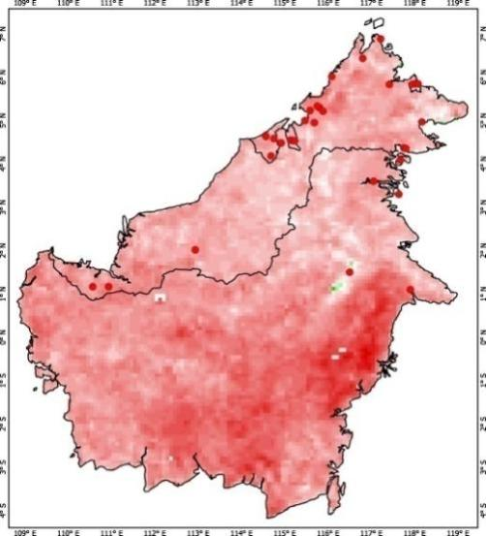
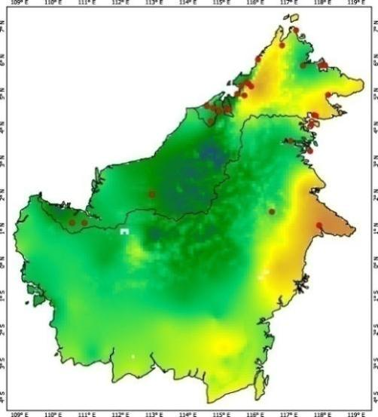
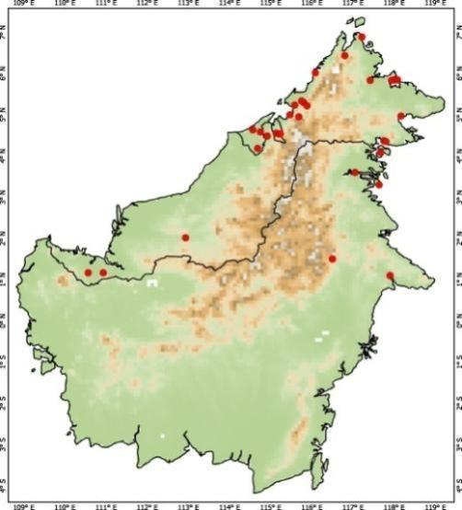
Methodology – Species Distribution Models
Notes:
Vervolgens gebruiken we klimaat gegevens (temperatuur/neerslag/bodem) om te onderzoeken wat de overeenkomst is in klimaat en het voorkomen van een soort. B.v. een soort komt uitsluitend voor wanneer de temperatuur tussen de 18-25 graden ligt en er voldoende neerslag valt.

Slide 47
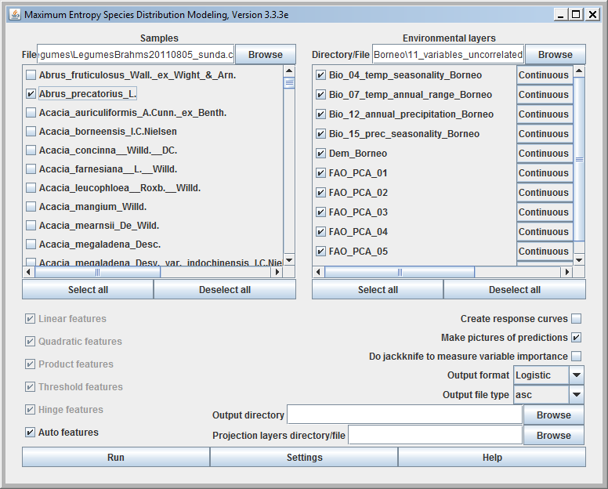
Methodology – Species Distribution Models
Notes:
Dit wordt gedaan met een computer programma (links)

Slide 48
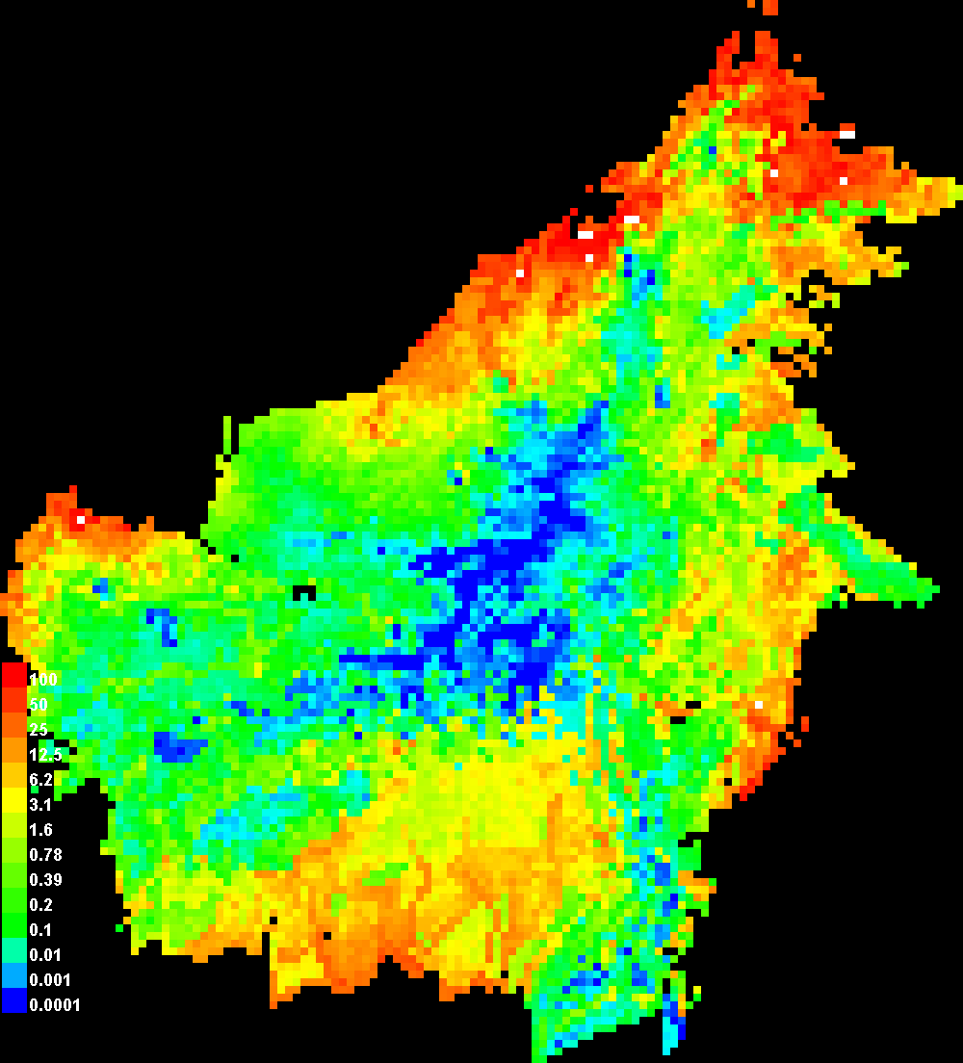
Methodology – Species Distribution Models
Notes:
En dit resulteert in een kaart die voorspeld waar een soort voorkomt. Witte stipjes zijn de collecties en waar het rood/oranje is komt de soort waarschijnlijk voor. Op deze manier is het mogelijk om voor de 79% van Borneo waar geen collecties van zijn te voorspellen welke soorten voorkomen.

Slide 49
Methodology – Species Distribution Models
Extract all collection data for species with at least 1 record on the Sunda Shelf from the collection databases: - BRAHMS Leiden - BRAHMS Forest Research Institute Malaysia - BRAHMS Singapore botanical gardens
Clean species identifications.
Georeference all collections.
Get spatial data that relates to the species’ abiotic niches.
Model algorithm to relates species occurrence to spatial data.
Statistical testing with a null-model.
Notes:
Last phase: testing if model deviates from random

Slide 50
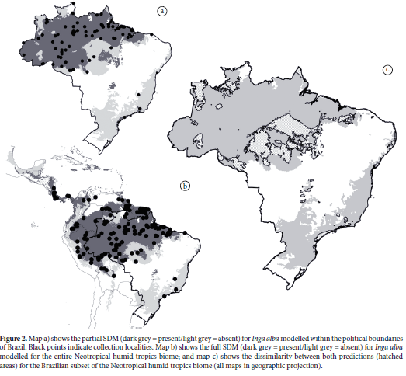
Intermezzo – a word on partial species distribution models or truncated niche models
Raes, N. 2012. Natureza & Conservacao
Notes:
Border effect: deel verspreiding versus complete.

Slide 51
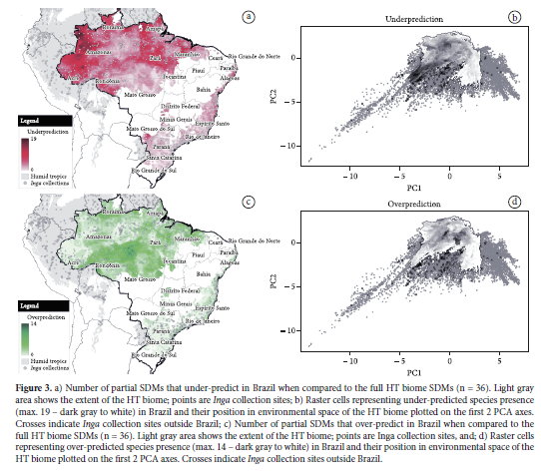
Intermezzo – a word on partial species distribution models or truncated niche models
Raes, N. 2012. Natureza & Conservacao
Notes:
Rood: underpredicted, groen: overprediction

Slide 52
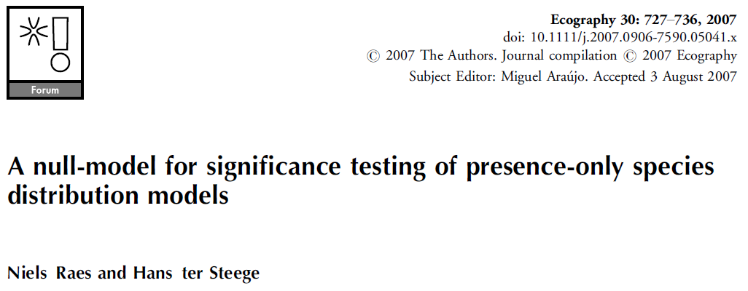
Statistical testing with a null-model
Notes:
Nul modellen

Slide 53

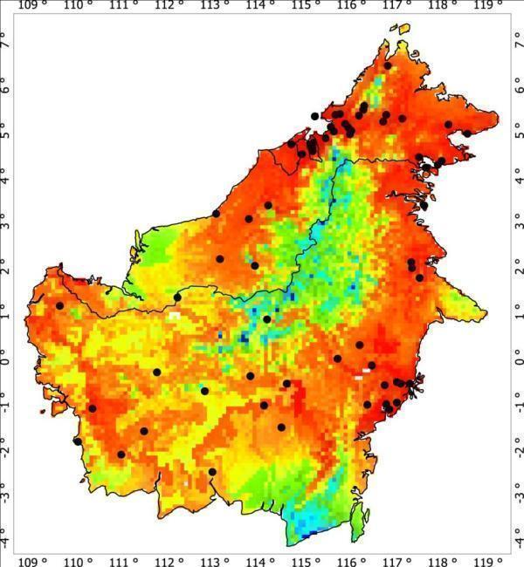
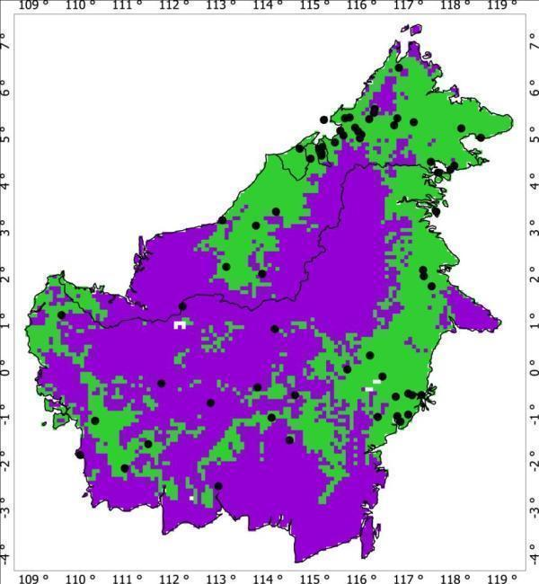
Statistical testing with a null-model
There are many measures of SDM accuracy, but one stands out !!!
AUC: Area Under the Curve of the Receiver Operating Characteristic (ROC) plot.
Threshold independent.
Notes:
53

Slide 54
Statistical testing with a null-model
There are many measures of SDM accuracy, but one stands out !!!
AUC: Area Under the Curve of the Receiver Operating Characteristic (ROC) plot.
Threshold independent.
Single measure of SDM accuracy.
Prevalence insensitive.
Prevalence = ______presences____
(presences + absences)
Notes:
54
Also independent on how many specimens.

Slide 55
Statistical testing against a null distribution
Absences – Standard procedure
Collection records are presence-only data i.e. plants are never NOT collected !!!
All statistics, including AUC, require absences,
Problem solved by the introduction of pseudo-absences.
Notes:
55

Slide 56
Statistical testing against a null distribution
Pseudo-absences
Definition:
Randomly selected sites across the study region at localities where no species presence was recorded, and for which species occurrence is set as absent.
A sufficient large sample of pseudo-absences is needed to represent the environmental variation in the study region, typically 1,000 – 10,000 points.
Notes:
56
Aantal pseudo-afwezigheden moet groot zijn!

Slide 57
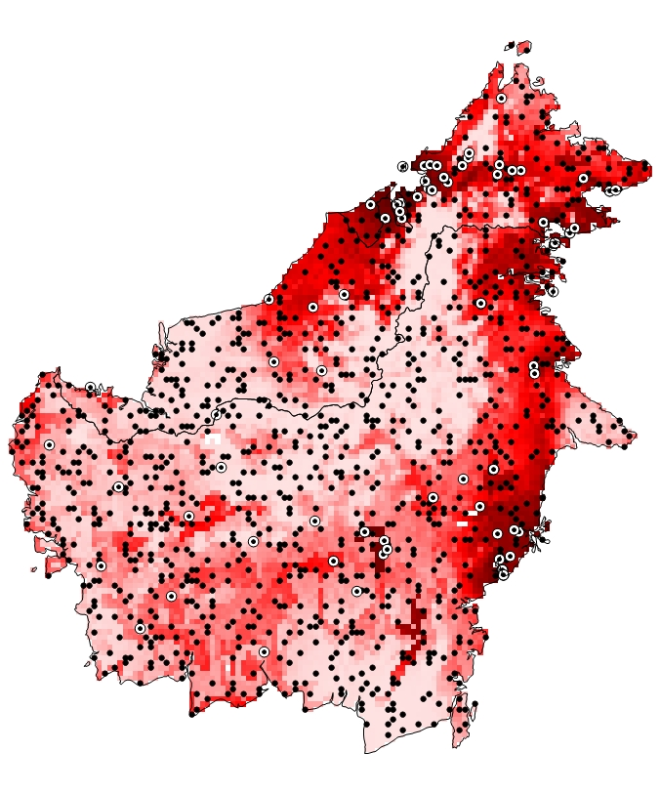
Statistical testing against a null distribution
Pseudo-absences
Definition:
Randomly selected sites across the study region at localities where no species presence was recorded, and for which species occurrence is set as absent.
A sufficient large sample of pseudo-absences is needed to represent the environmental variation in the study region, typically 1,000 – 10,000 points.
Notes:
57
In wit met zwart: aanwezig, zwarte pseudo absence.

Slide 58
Statistical testing against a null distribution
Pseudo-absences
Definition:
Randomly selected sites across the study region at localities where no species presence was recorded, and for which species occurrence is set as absent.
A sufficient large sample of pseudo-absences is needed to represent the environmental variation in the study region, typically 1,000 – 10,000 points.
Prevalence | 69 . (69+1,000) | = 0.07
Notes:
58
Prevalence with 69 presence data

Slide 59

Statistical testing against a null distribution
Get SDM values for presences and pseudo-absences.
Notes:
59

Slide 60
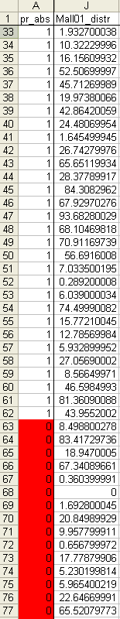

Statistical testing against a null distribution
Predicted | Actual
 | Presence | Pseudo-absence
Presence | a | c
Absence | b | d
Sensitivity: a/(a+b)
1 - Specificity: 1 – (d/(c+d))
Notes:
Area under the curve is in fact an error analysis. You like presence and absence to be 100% and you do not want false conditions, thus an absence when something is present, or the other way around (B and C). In the table on the left the SDM value for every presence and pseudo-absence, on the right ranked according to height of SDM value

Slide 61

Statistical testing against a null distribution
Predicted | Actual
 | Presence | Pseudo-absence
Presence | 1 | 0
Absence | 68 | 1000
 | 69 | 1000
Sensitivity: 1/(1+68) = 0.015
1 - Specificity: 1 – (1000/(0+1000)) = 0.000
1-Specificity

Slide 62
Statistical testing against a null distribution
Predicted | Actual
 | Presence | Pseudo-absence
Presence | 7 | 25
Absence | 62 | 975
 | 69 | 1000
Sensitivity: 7/(7+62) = 0.101
1 - Specificity: 1 – (975/(25+975)) = 0.025
Area Under Curve 0.849
i.e.
1-Specificity

Slide 63
Statistical testing against a null distribution
AUC: The probability, when a presence site and a (pseudo-) absence site are drawn at random, that the presence site has a higher predicted value than the (pseudo-) absence site.
Accuracy:
AUC = 0.5 → Random Prediction
0.5 < AUC < 0.7 → Low Model Accuracy
0.7 < AUC < 0.9 → Useful Applications
0.9 < AUC < 1.0 → High Model Accuracy
AUC = 1.0 → Perfect Model Fit
Notes:
63

Slide 64
Statistical testing against a null distribution
PROBLEM !!!
“When AUC statistics are applied to presence-only data and pseudo-absences, the maximum achievable AUC value is no longer 1, BUT 1- a/2; where a stands for the true species’ distribution, which we typically do not know” (Phillips et al. 2006)
AUC measures of model accuracy do NOT apply !!!
Notes:
64

Slide 65
Statistical testing against a null distribution
SOLUTION
Instead of using subjective thresholds of accuracy, which do NOT apply, to test the model AUC value against a null-model.
What is a null-model?
Pattern-generating model based on random sampling from a known or imagined distribution, or randomizations of ecological data (Gotelli and McGill 2006).
Tests whether chance alone is enough to explain the observed patterns.
Straightforward and closely resembles hypothesis testing in conventional statistical analyses.
Notes:
65

Slide 66
Statistical testing against a null distribution
How to generate a null-model?
Draw 1000 times equally many points from the study area as there are species records. 1000 x 69 random points
Model all 1000 series similarly as the species model.
Calculate the 1000 AUC values and rank them from low to high.
Assess the 95% one-sided confidence interval value. 0.95 x 1000 = 950th AUC value
Test whether the species’ model AUC value is significantly higher than the 950th null distribution AUC value.
Notes:
66

Slide 67

Statistical testing against a null distribution
Notes:
67

Slide 68
Statistical testing against a null distribution
Linear + quadratic + hinge
Linear + quadratic
Linear
Notes:
68

Slide 69
Statistical testing against a null distribution
Notes:
69

Slide 70

Statistical testing against a null distribution
How to generate a BIAS CORRECTED null-model?
Notes:
70

Slide 71

Statistical testing against a null distribution
How to generate a BIAS CORRECTED null-model?
Notes:
71

Slide 72

Statistical testing against a null distribution
How to generate a BIAS CORRECTED null-model?
No significant difference between collection sites and whole of Borneo
Notes:
72

Slide 73

Statistical testing against a null distribution
Notes:
73

Slide 74
SDM applications

Slide 75
SDMs – species level

Slide 76

SDMs – species level

Slide 77

SDMs – species level

Slide 78

SDMs – species level

Slide 79
Species Distribution Modelling - History
Hutchinson’s n-dimensional niche hypervolume
Notes:
Niche van aap: waar optimaal op basis van drie variabelen, meer natuurlijk toe te voegen.

Slide 80



SDMs – species level
Which role play geography and ecology in speciation? (Nakazato et al. 2009, Am. J. Bot. 97(4): 680-693).
Notes:
Solanum (tomato) species, each a slightly different niche. Lines give mean values per variable, on variable the variation.

Slide 81


SDMs – species level
Quantifying niche differences between species (Evans et al. 2009, Am. Nat. 173(2): 225-240).
Notes:
Oenothera

Slide 82

SDMs – species level
Quantifying niche differences between species (Evans et al. 2009, Am. Nat. 173(2): 225-240).
Notes:
Distributions

Slide 83

SDMs – species level
Quantifying niche differences between species (Evans et al. 2009, Am. Nat. 173(2): 225-240).
Notes:
Reactions to species to mean annual temp. Every colour different species/subspecies

Slide 84


SDMs – species level
Invasive species (data S. Janssens).
Impatiens sp.
Notes:
Impatiens species (new), naturally present in Himalayas

Slide 85

SDMs – species level
Invasive species (data S. Janssens).
Notes:
Introduced in Europe. Question: can it become a pest / invasive species in Europe.

Slide 86

SDMs – species level
Invasive species (data S. Janssens).
Notes:
SDM made for Himalayas, same values for variables then translated to Europe

Slide 87

SDMs – species level
Invasive species (data S. Janssens).
Notes:
Result: most of Europe suitable, thus pest potential.

Slide 88













SDMs – community level
Biodiversity (N. Raes)
+
+
Notes:
You can stack all sdm’s

Slide 89


Biodiversity pattern of Java
Notes:
Here same for Java: species richest on volcanoes, less along coasts.

Slide 90

Overall biodiversity (n = 1297)
Notes:
Biodiversity based on SDM of 7 plant families.

Slide 91

Legumes (n = 423)
Notes:
Here only based on Fabaceae, beans. Question: are beans already indicative enough to predict where highest biodiversity can be found.

Slide 92


Diversity = 265.93 + 0.45 × Legumes (p<0.001; R² adj = 0.012)
Diversity (n = 1297)
Legumes (n = 423)
Notes:
If all legumes are taken together: answer No.

Slide 93




Trees (n = 120)
Lianas (n = 124)
Herbs (n = 83)
Misc. (n = 96)
Notes:
Trees and lianas better predictors

Slide 94

Diversity = 119.90 + (10.67 × lianas) – (0.37 × herbs) – (5.06 × misc.) (p<0.001; R² adj = 0.783)

Slide 95

Residuals - Diversity ~ Legumes

Slide 96
SDMs – community level
Biogeography / floristic regios (N. Raes)
Species | Sp. 1 | Sp. 2 | Sp. 3 | Sp. 4 | Sp. …
Loc. 1 | 1 | 1 | 0 | 0 | …
Loc. 2 | 1 | 1 | 1 | 0 | …
Loc. 3 | 0 | 1 | 1 | 0 | …
Loc. 4 | 0 | 0 | 1 | 1 | …
Loc. … | … | … | … | … | …
Notes:
Stacking: per grid cell note per species presence or absence in model

Slide 97

New developments
Biogeography / floristic regions (N. Raes)
Notes:
Then cluster analysis reveals floristic regions

Slide 98


Floristic regions of Java
Notes:
Same for Java

Slide 99

Floristic regions of Java
1
3
5
6
2
4

Slide 100


Floristic regions of Java
Notes:
Areas 5 and 6 rather species poor, but typical areas: thus high biodiversity not always measure for uniqueness.

Slide 101


SDMs – community level
Phylogenetic diversity (N. Raes)
Notes:
Cladogram of all species in Borneo, dots indicate species modelled for central grid cell, in thick lines the phylogenetic distance.

Slide 102

Nieuwe ontwikkelingen
Genus phylogeny for Borneo dated according Wikström et al. 2001 (regional pool)
Phylogenetische diversiteit (N. Raes)

Slide 103


SDMs – community level
Phylogenetic diversity (N. Raes)
Notes:
You can do this for every cell and get a measure. In red areas with high phylogenetic signal, in blue with low. On right biodiversity. Not always an equal match.

Slide 104

SDMs – LGM hind-casts
Notes:
Dipterocarpaceae occurrences

Slide 105

SDMs – LGM hind-casts
Notes:
During lgm sunda shelf dry and may have contained high dipterocarp forest in areas (e.g. between Borneo and Bangka)

Slide 106

SDMs – LGM hind-casts
Raes et al. 2014 PNAS
Notes:
Here compared to climate models in past. Miroc-esm best.

Slide 107

Questions ?

